Slide 1
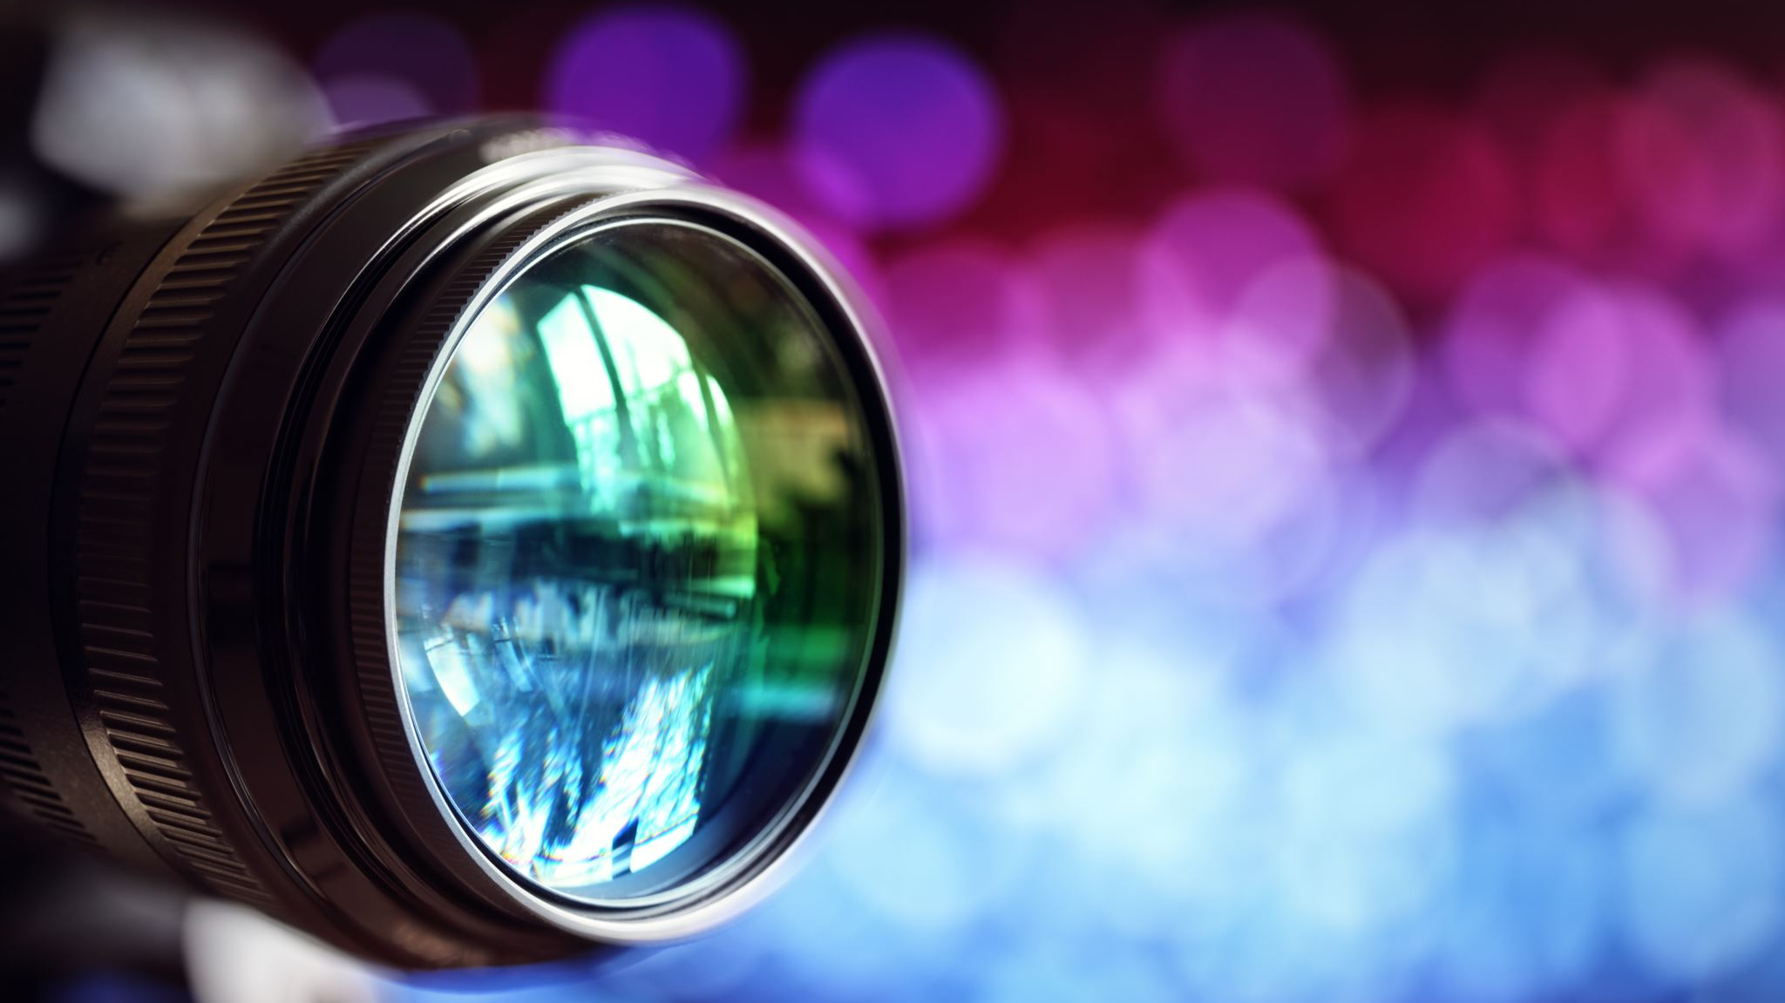
BEST PHOTO CONTEST

Slide 2
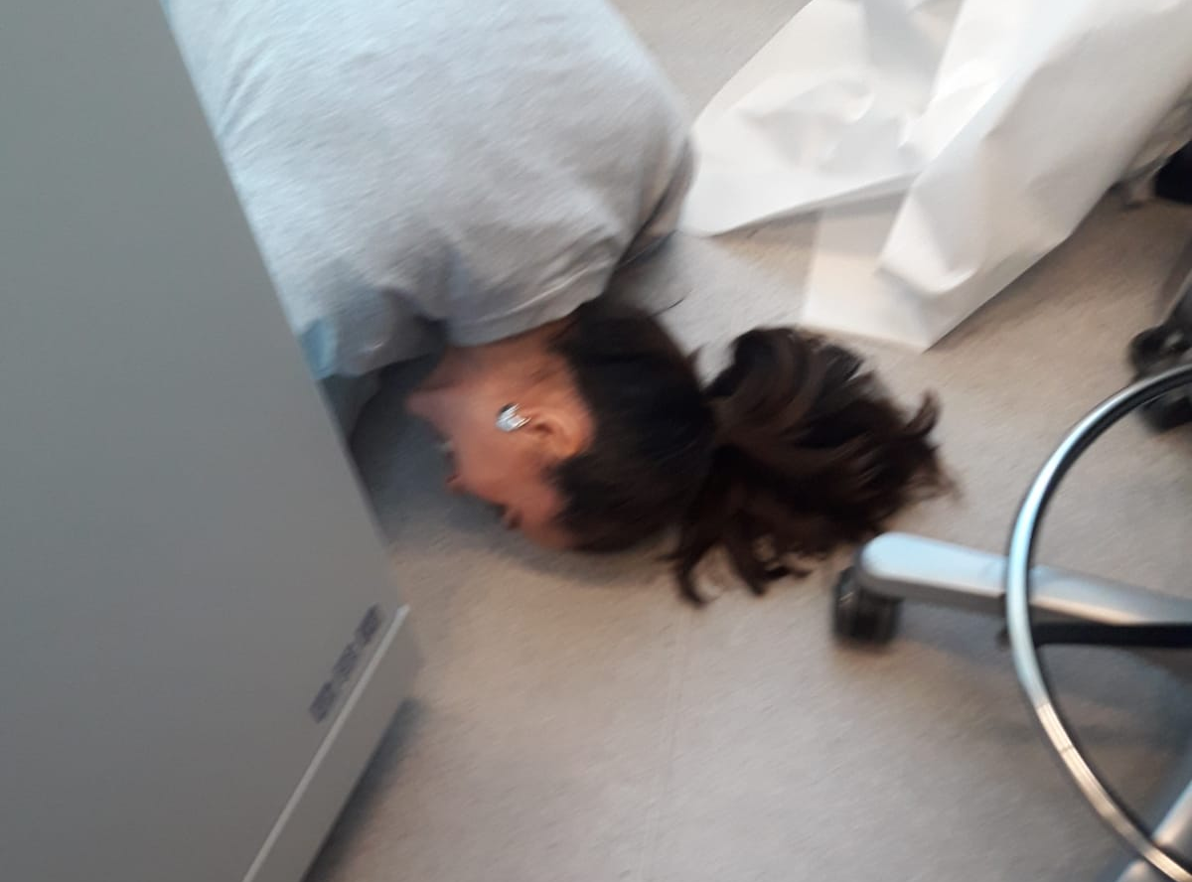
Nominated1
Picture1
What is the best method to clean a virus lab?
Use a colleague with long hair
Esmaeil Dorraji

Slide 3
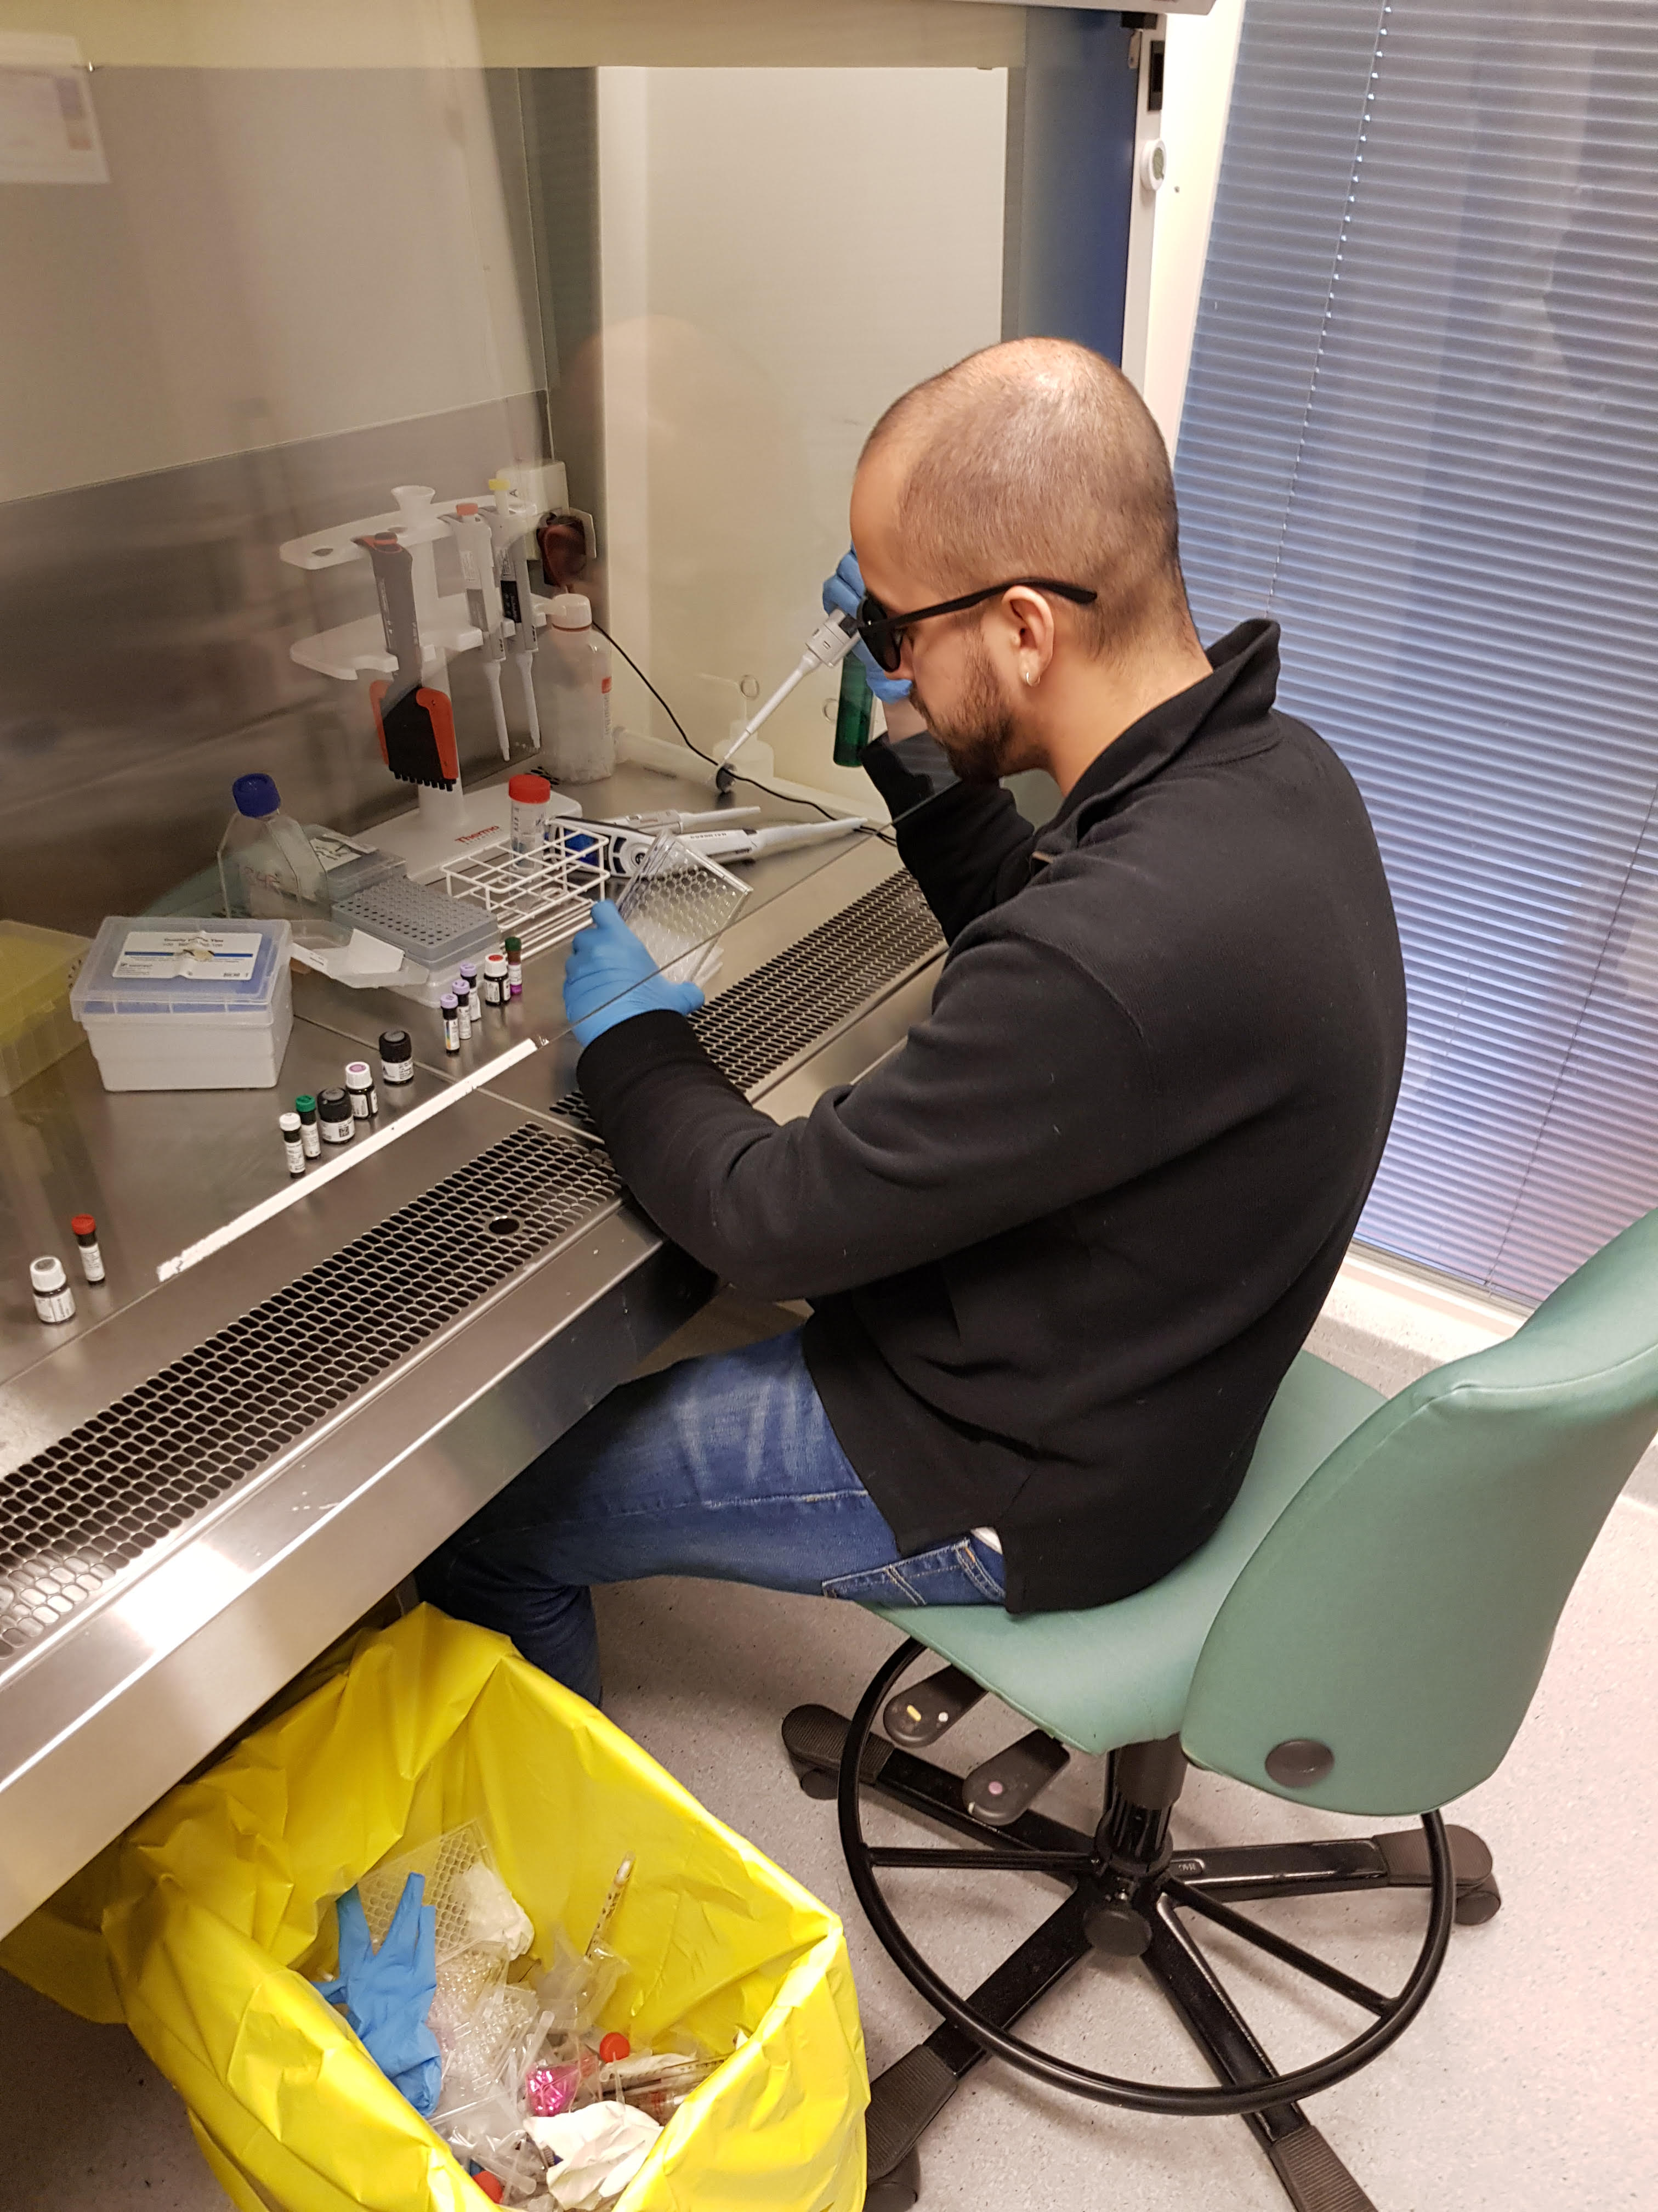
Picture4
Nominated2
Nomination : Dennis Clement
Title: Double-blinded study
Subject (Daniel O. P.)
(he suffered from an actual eye infection and maybe residual levels of alcohol in his blood stream?)

Slide 4
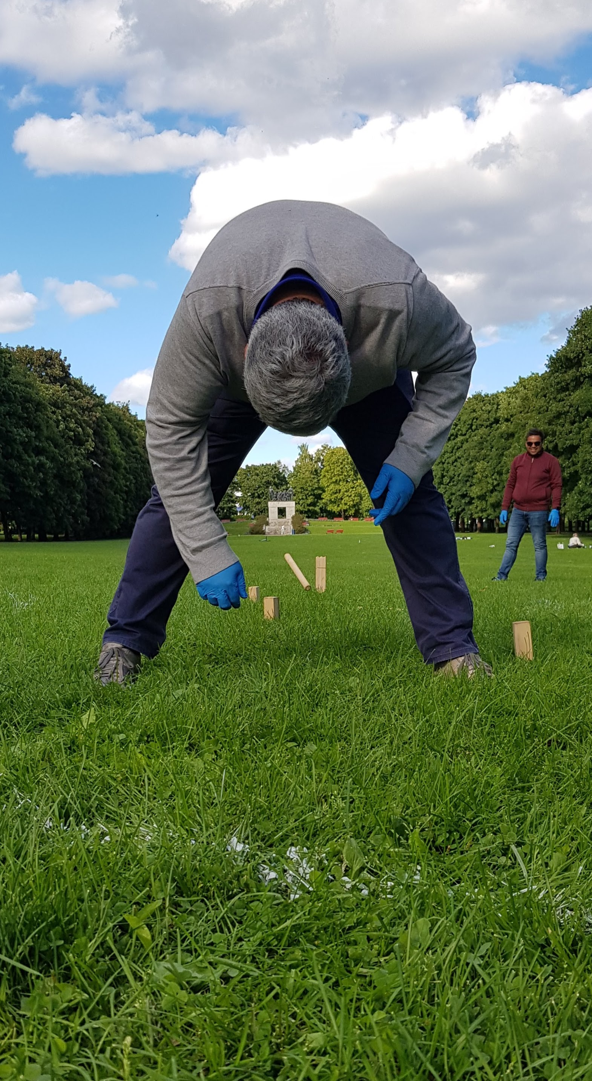
Nominated 3
Picture2
Couldn't resist this challenge, but I'll have to nominate myself...sending a picture of how we are turning the world up-side-down to hit The Target in the spirit of Corona. The person in the middle of the picture is Leonardo A. Meza-Zepeda, and this is taken from a group trip to Frognerparken on a late summer day in 2020.
I will not attend the party this year, though.
Best,
Nomination : Heidi M Namløs

Slide 5
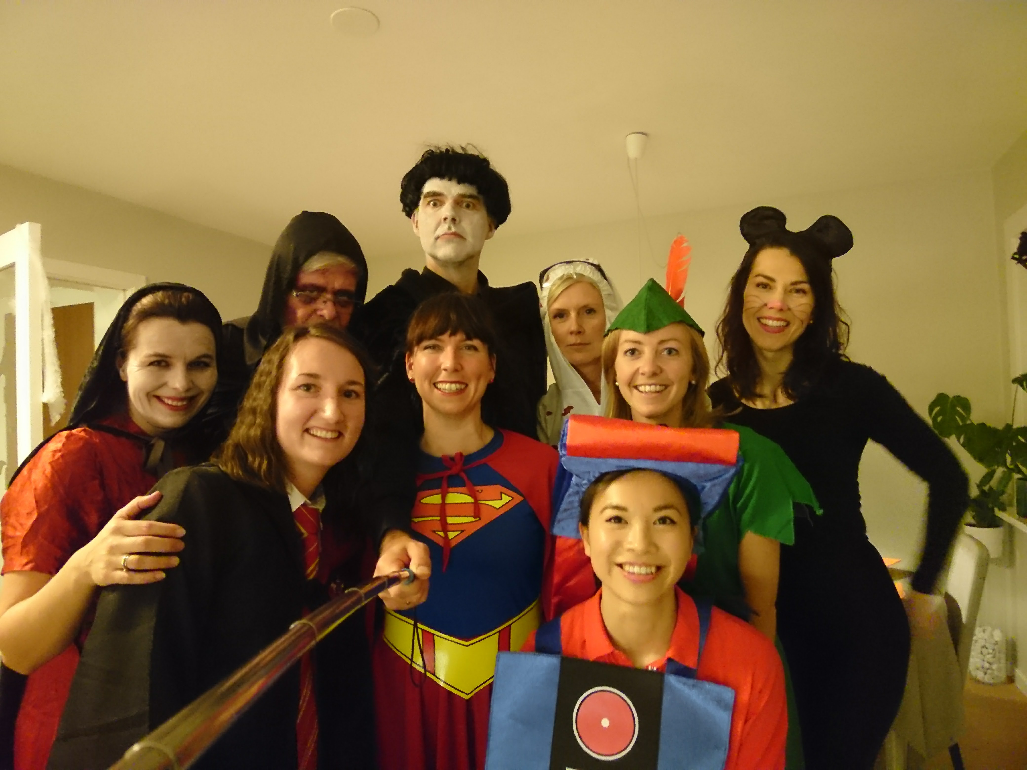
Picture 9
Nominated 4
Hei,
Bildet er tatt i 2018 og viser en gjeng fra Avd. for strålingsbiologi (PCI-gruppen) som har det gøy!
Fotograf? Han som bruker selfiestang…
Nomination:
Pål Kristian Selbo,

Slide 6
NOMINATED FINAL
Nominee 1
Nominee 2
Nominee 3
Nominee 4

Slide 7
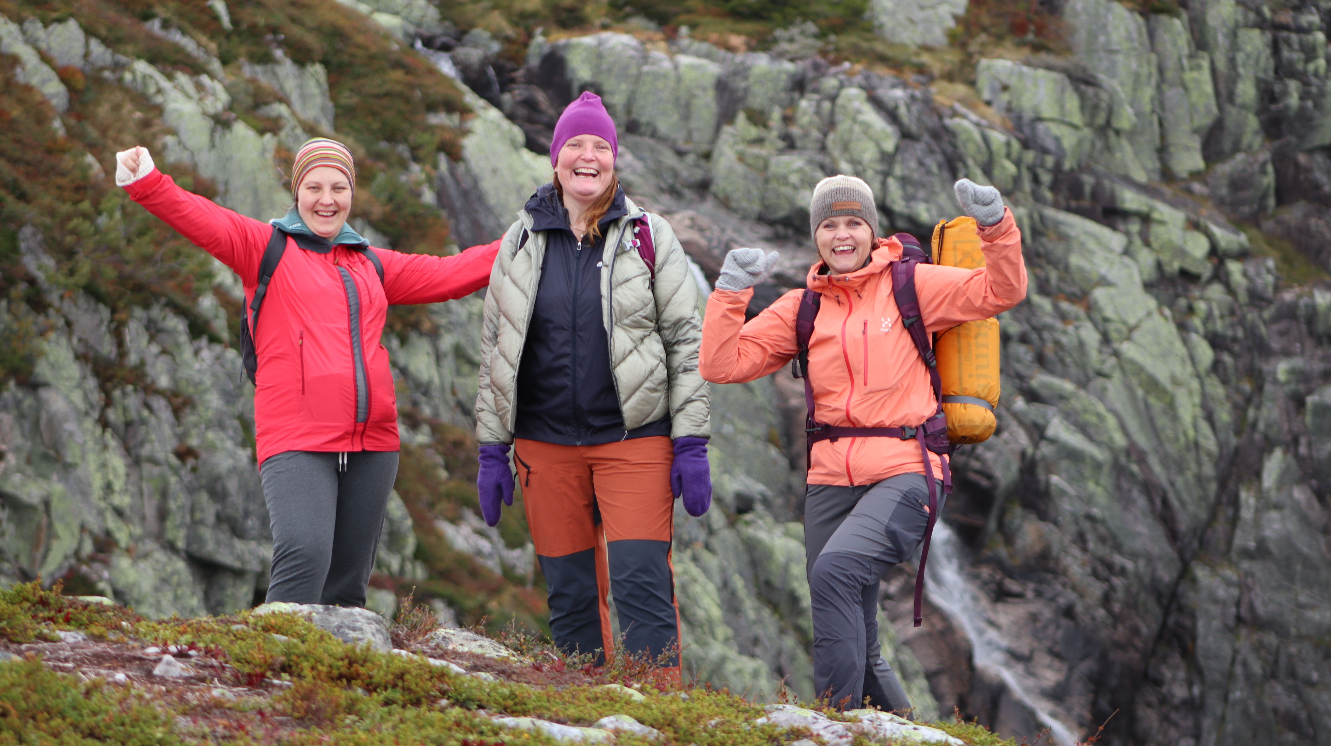
Picture 7
Nominated 4
Image name : After grant submission bliss
Nomination: Ankush

Slide 8
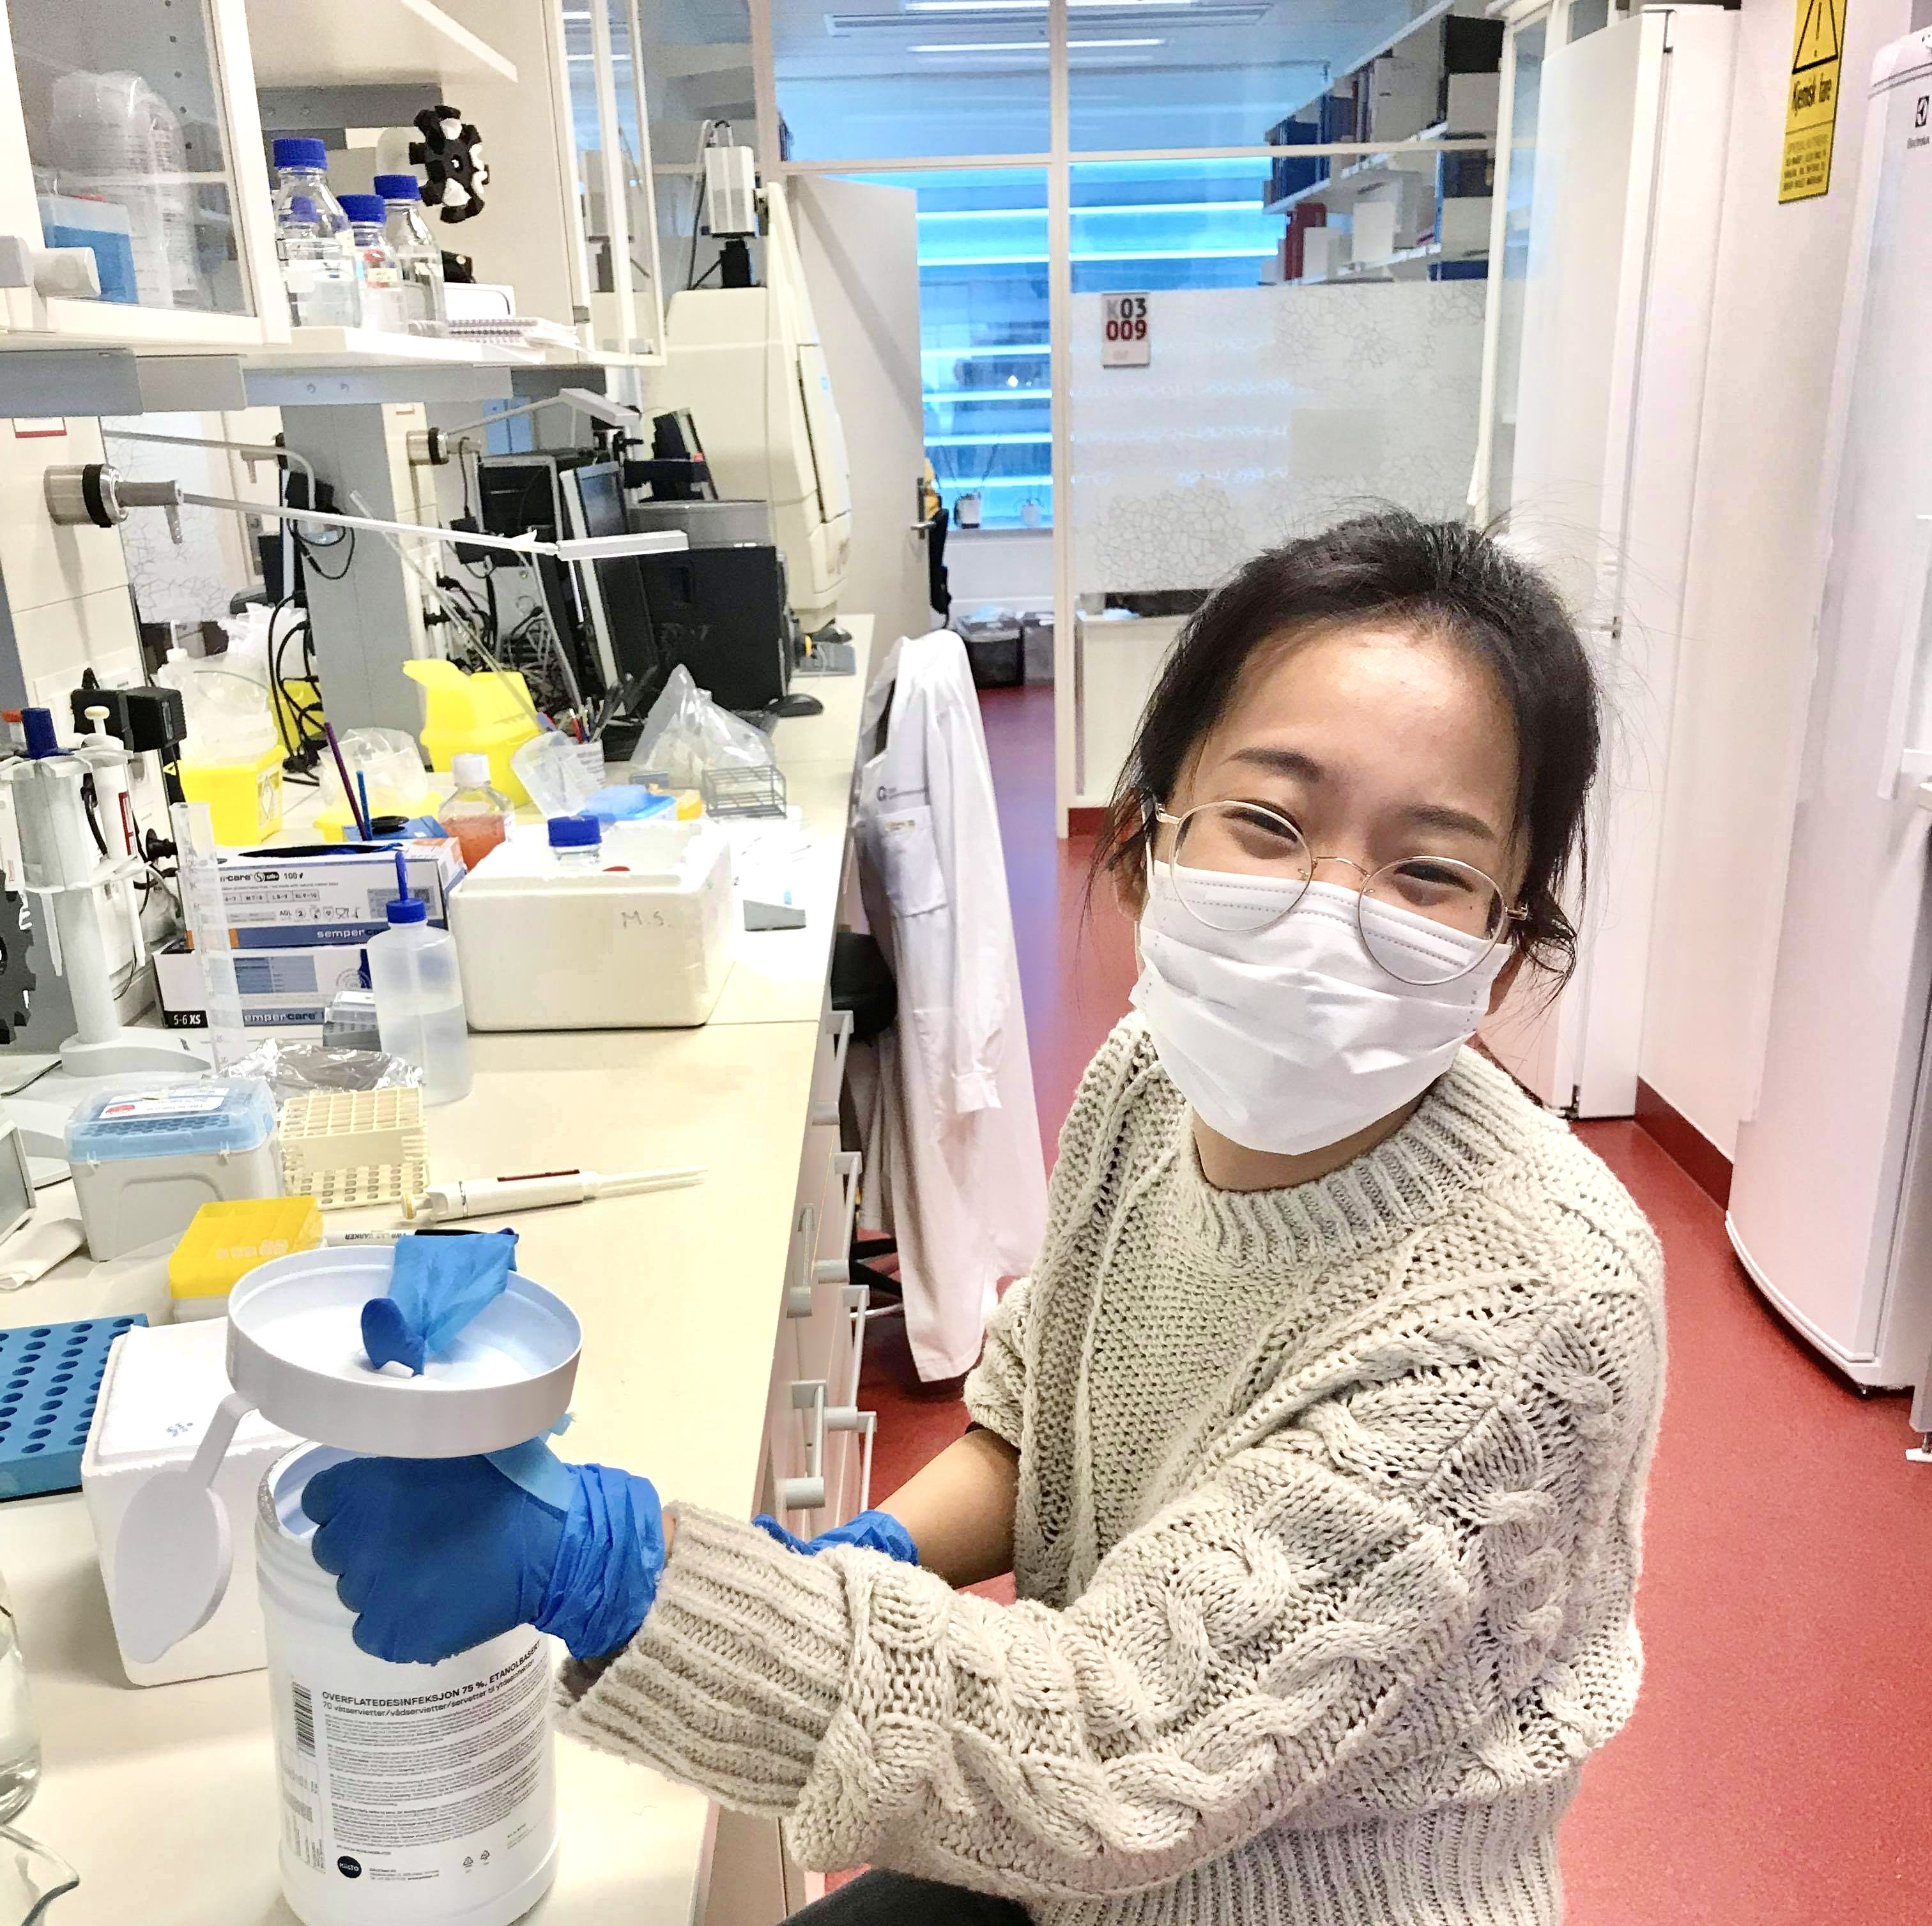
Picture 11
Nominated 3
Nomination
Qindong Zhang

Slide 9
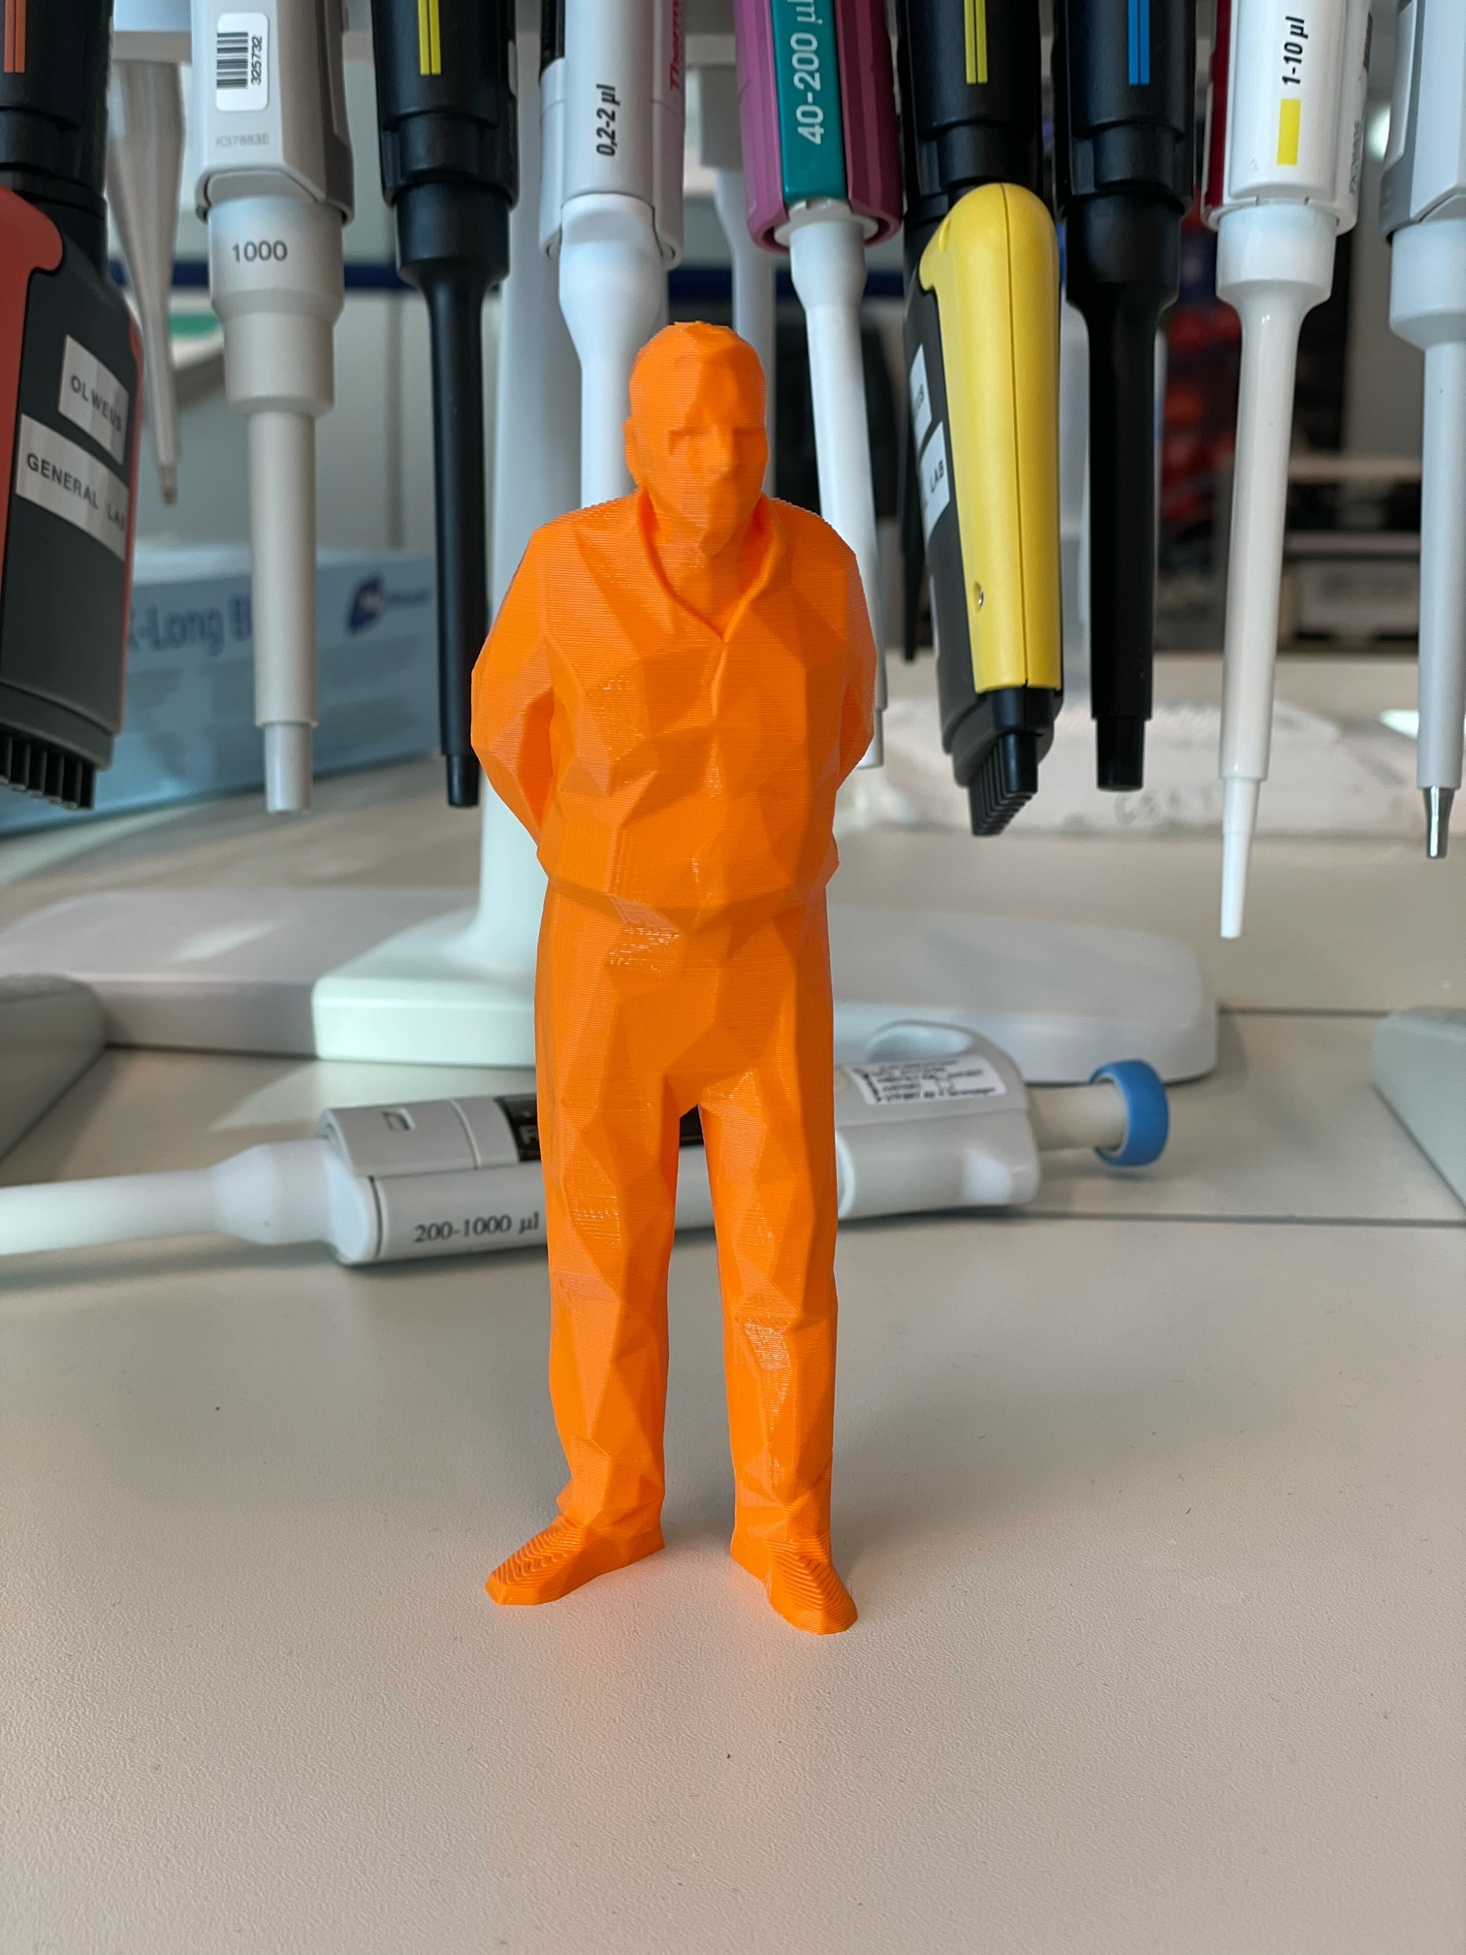
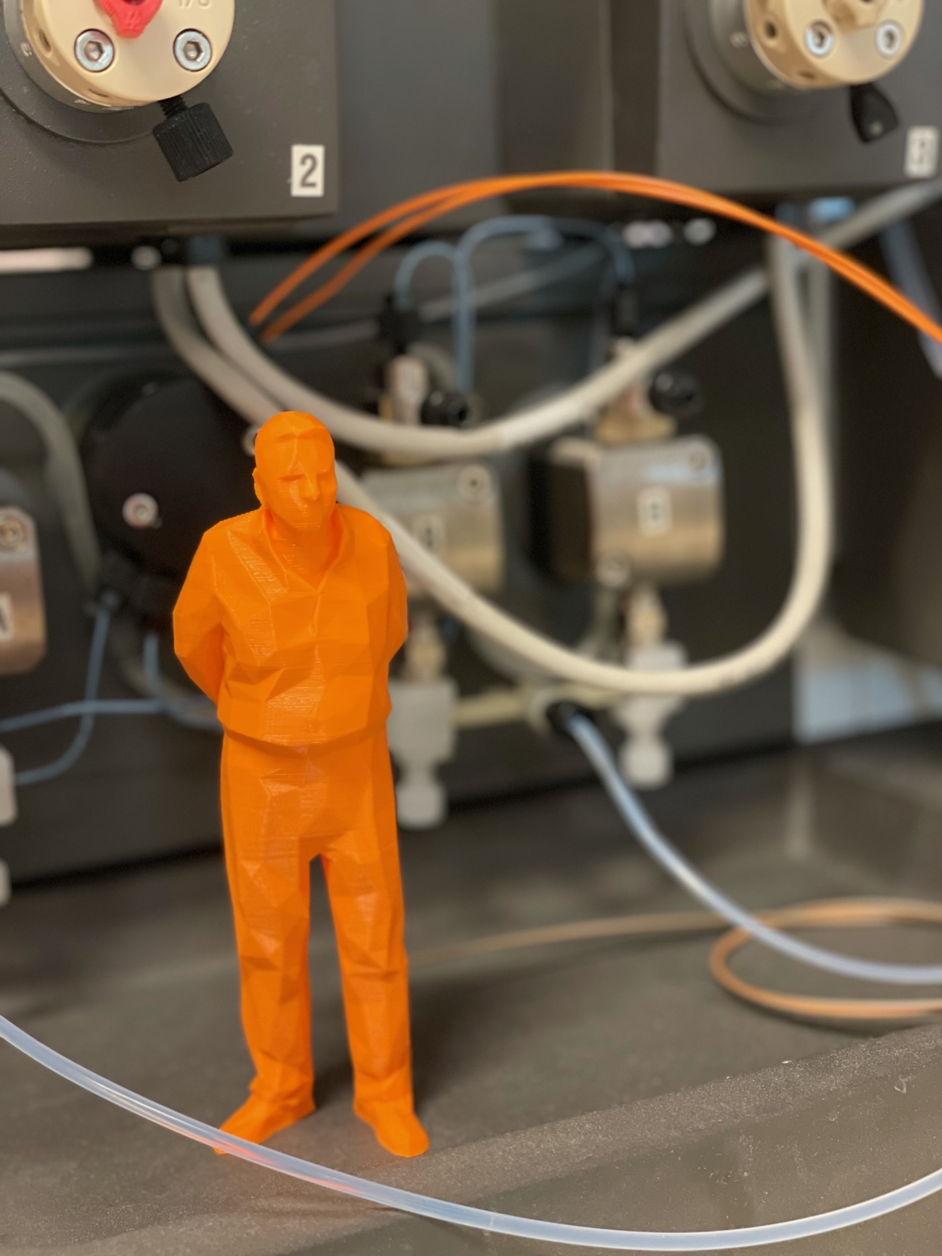
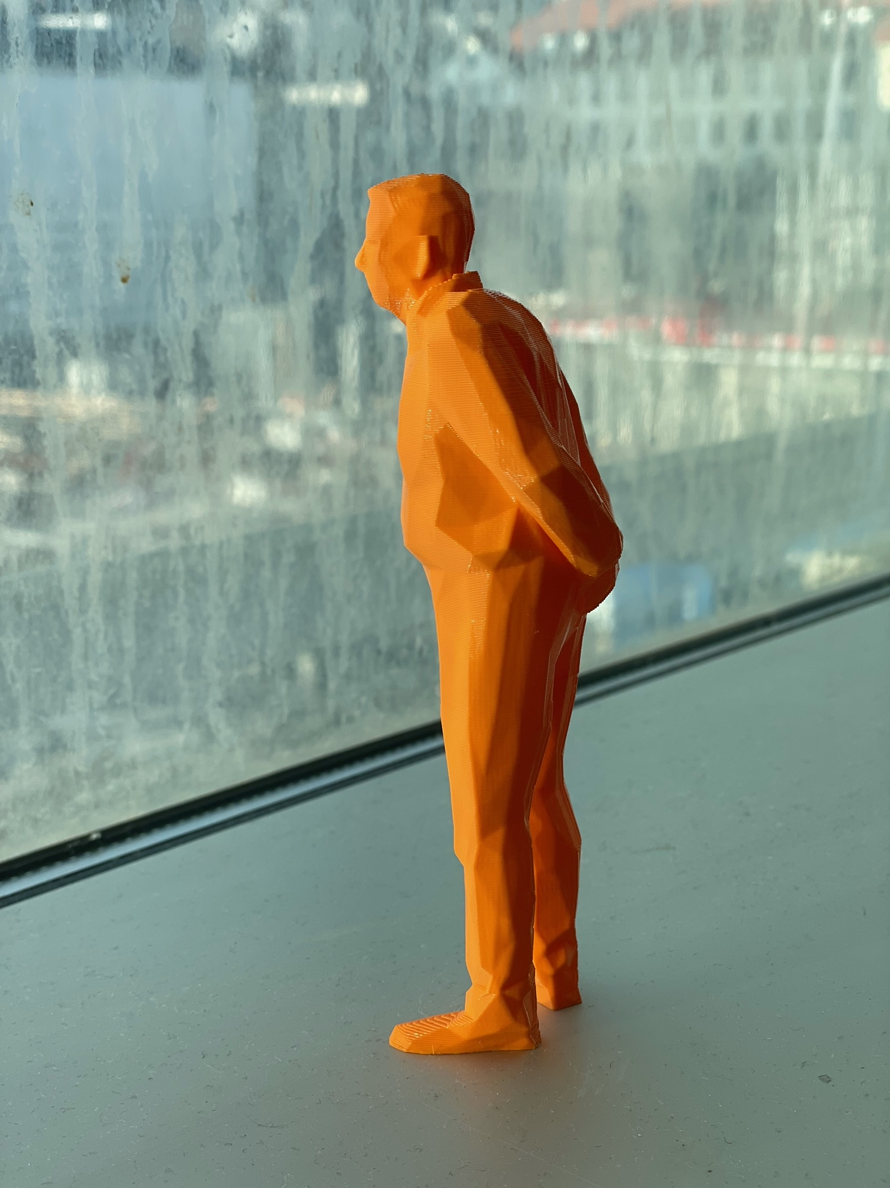
No title
Picture 3
Karl-Johan Malmberg

Slide 10
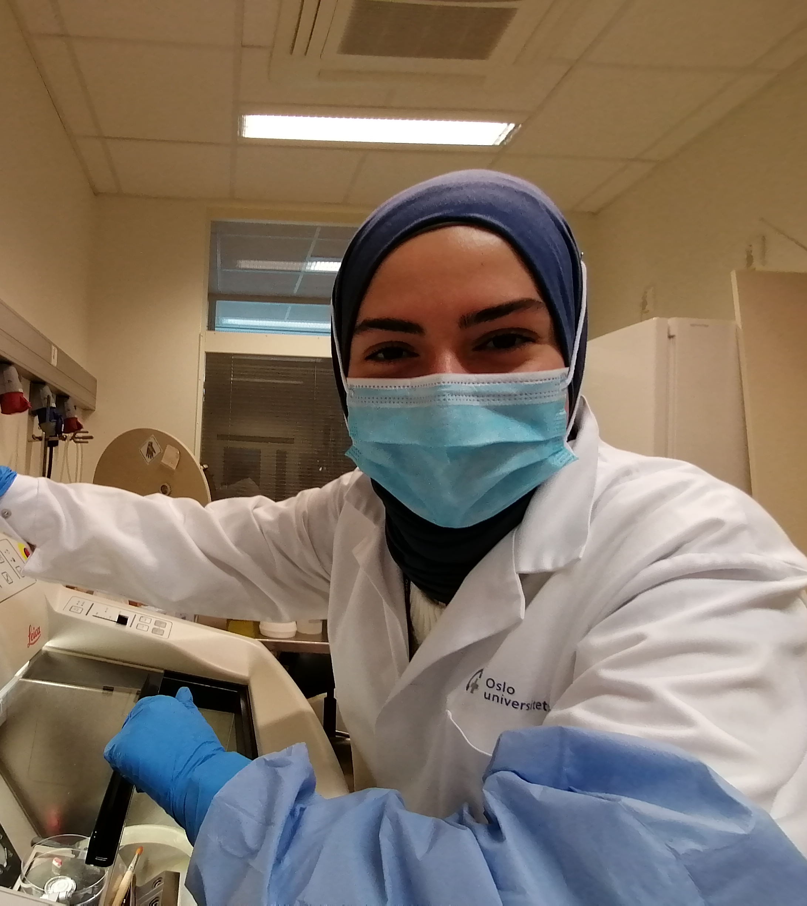
Picture 5
The beauty and the beast: Feyza vs the cryostat!
Nomination
Miriam Formica

Slide 11
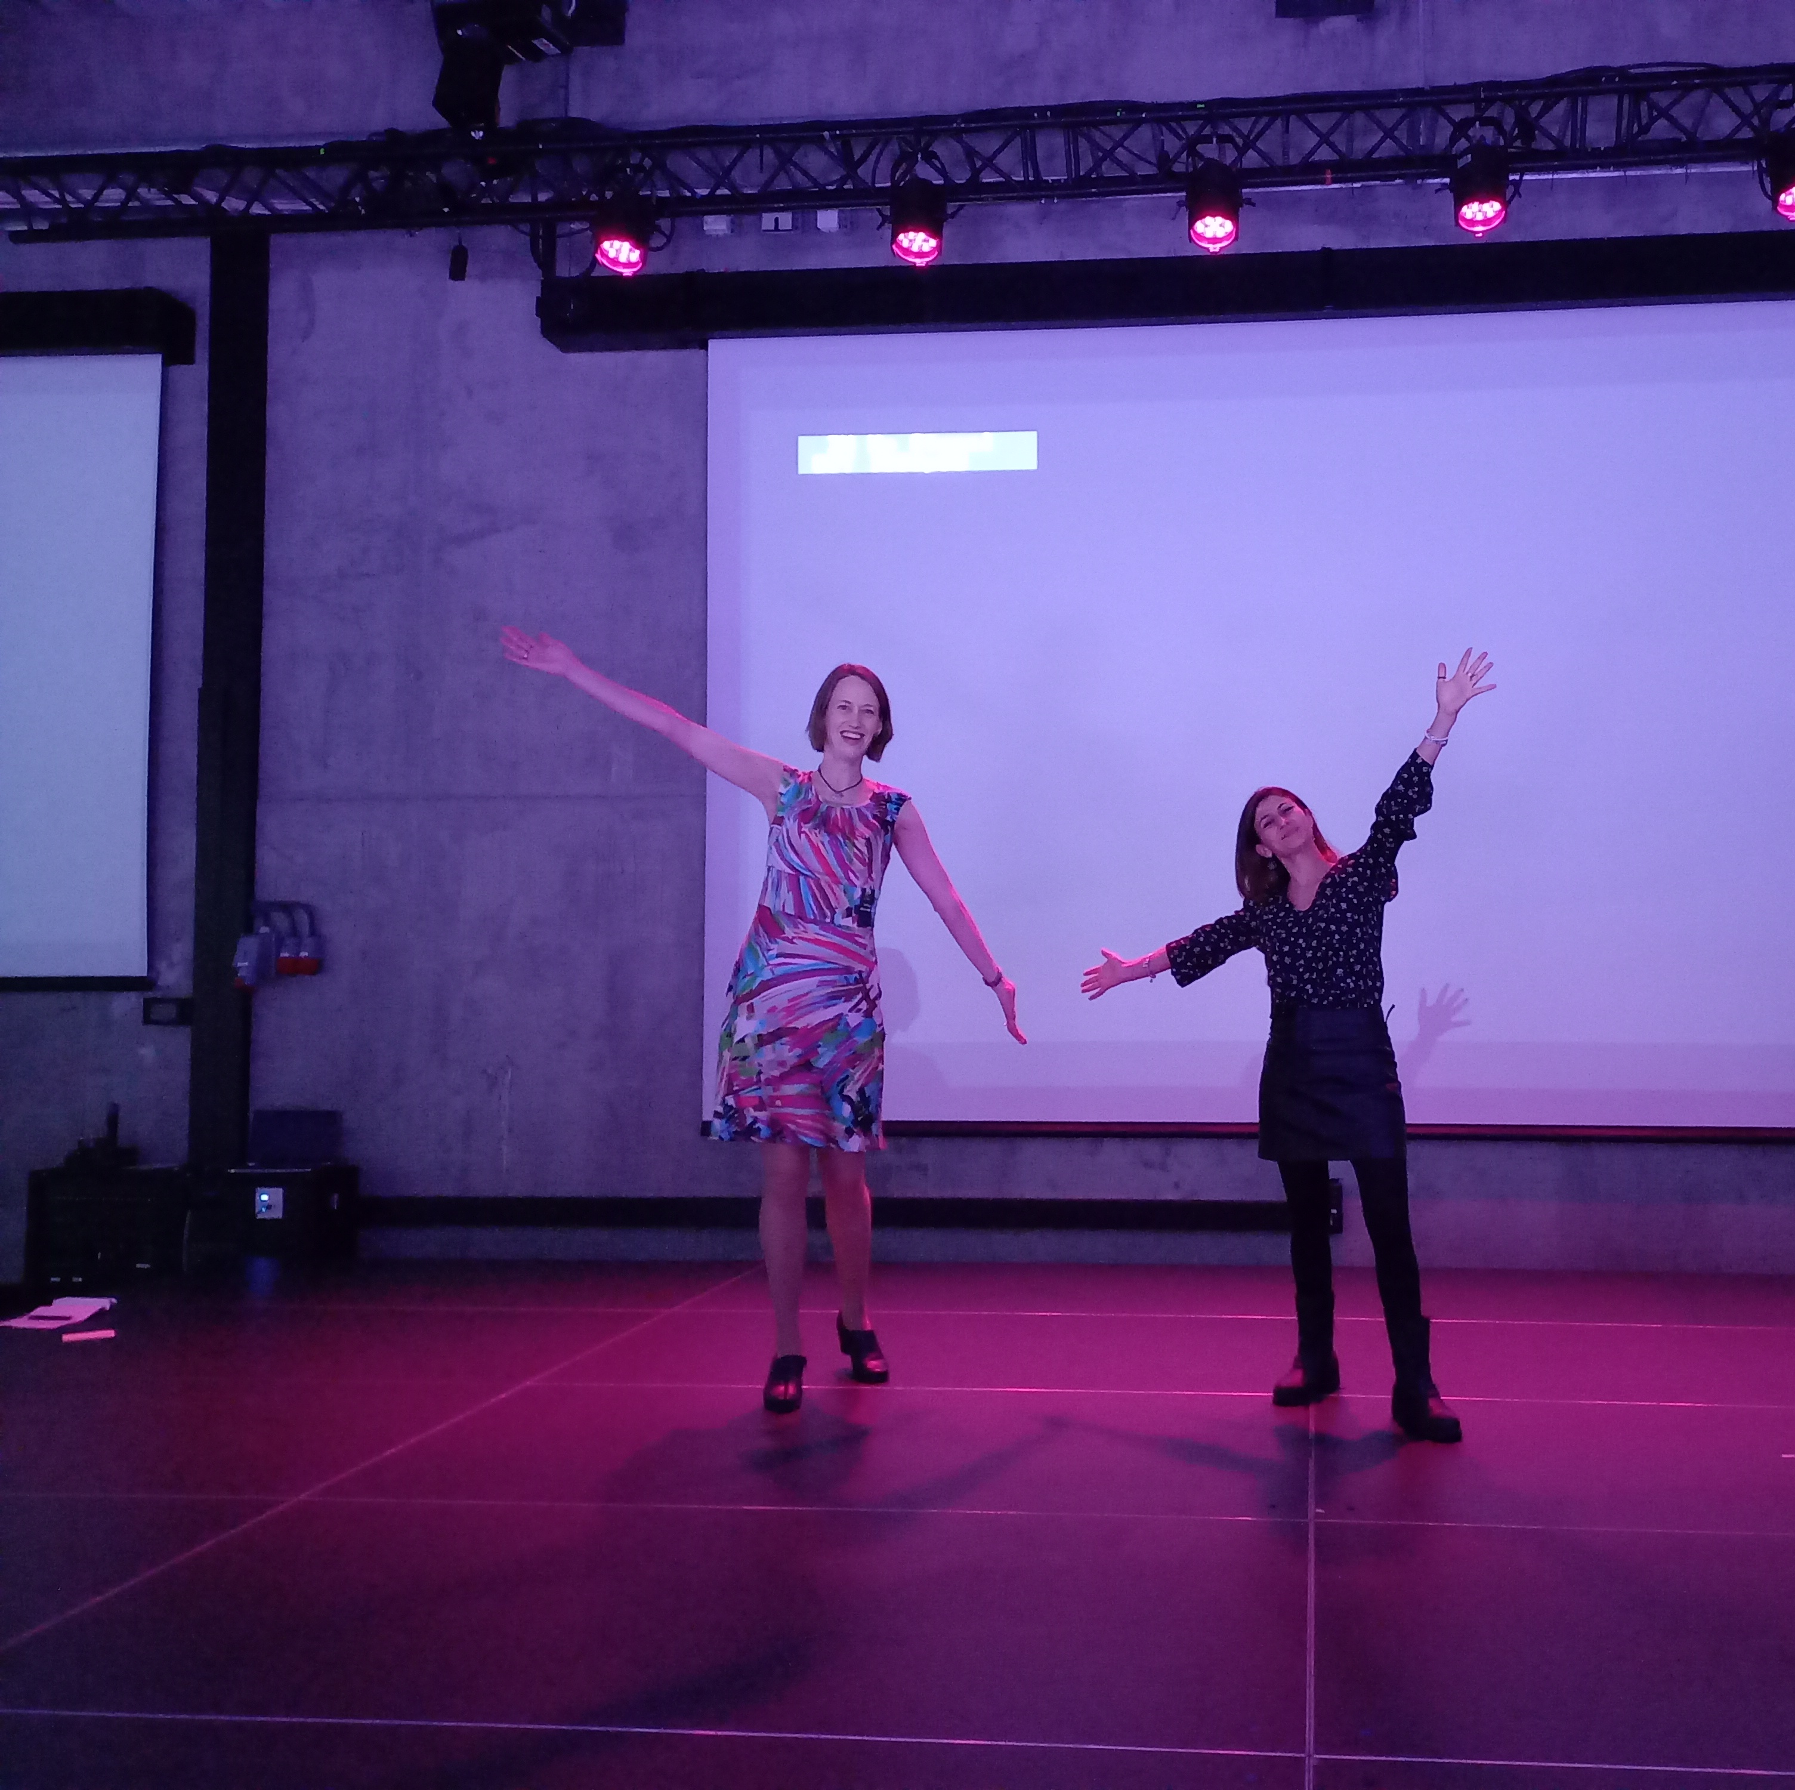
Picture6
Nomination: Mary-Ann

Slide 12
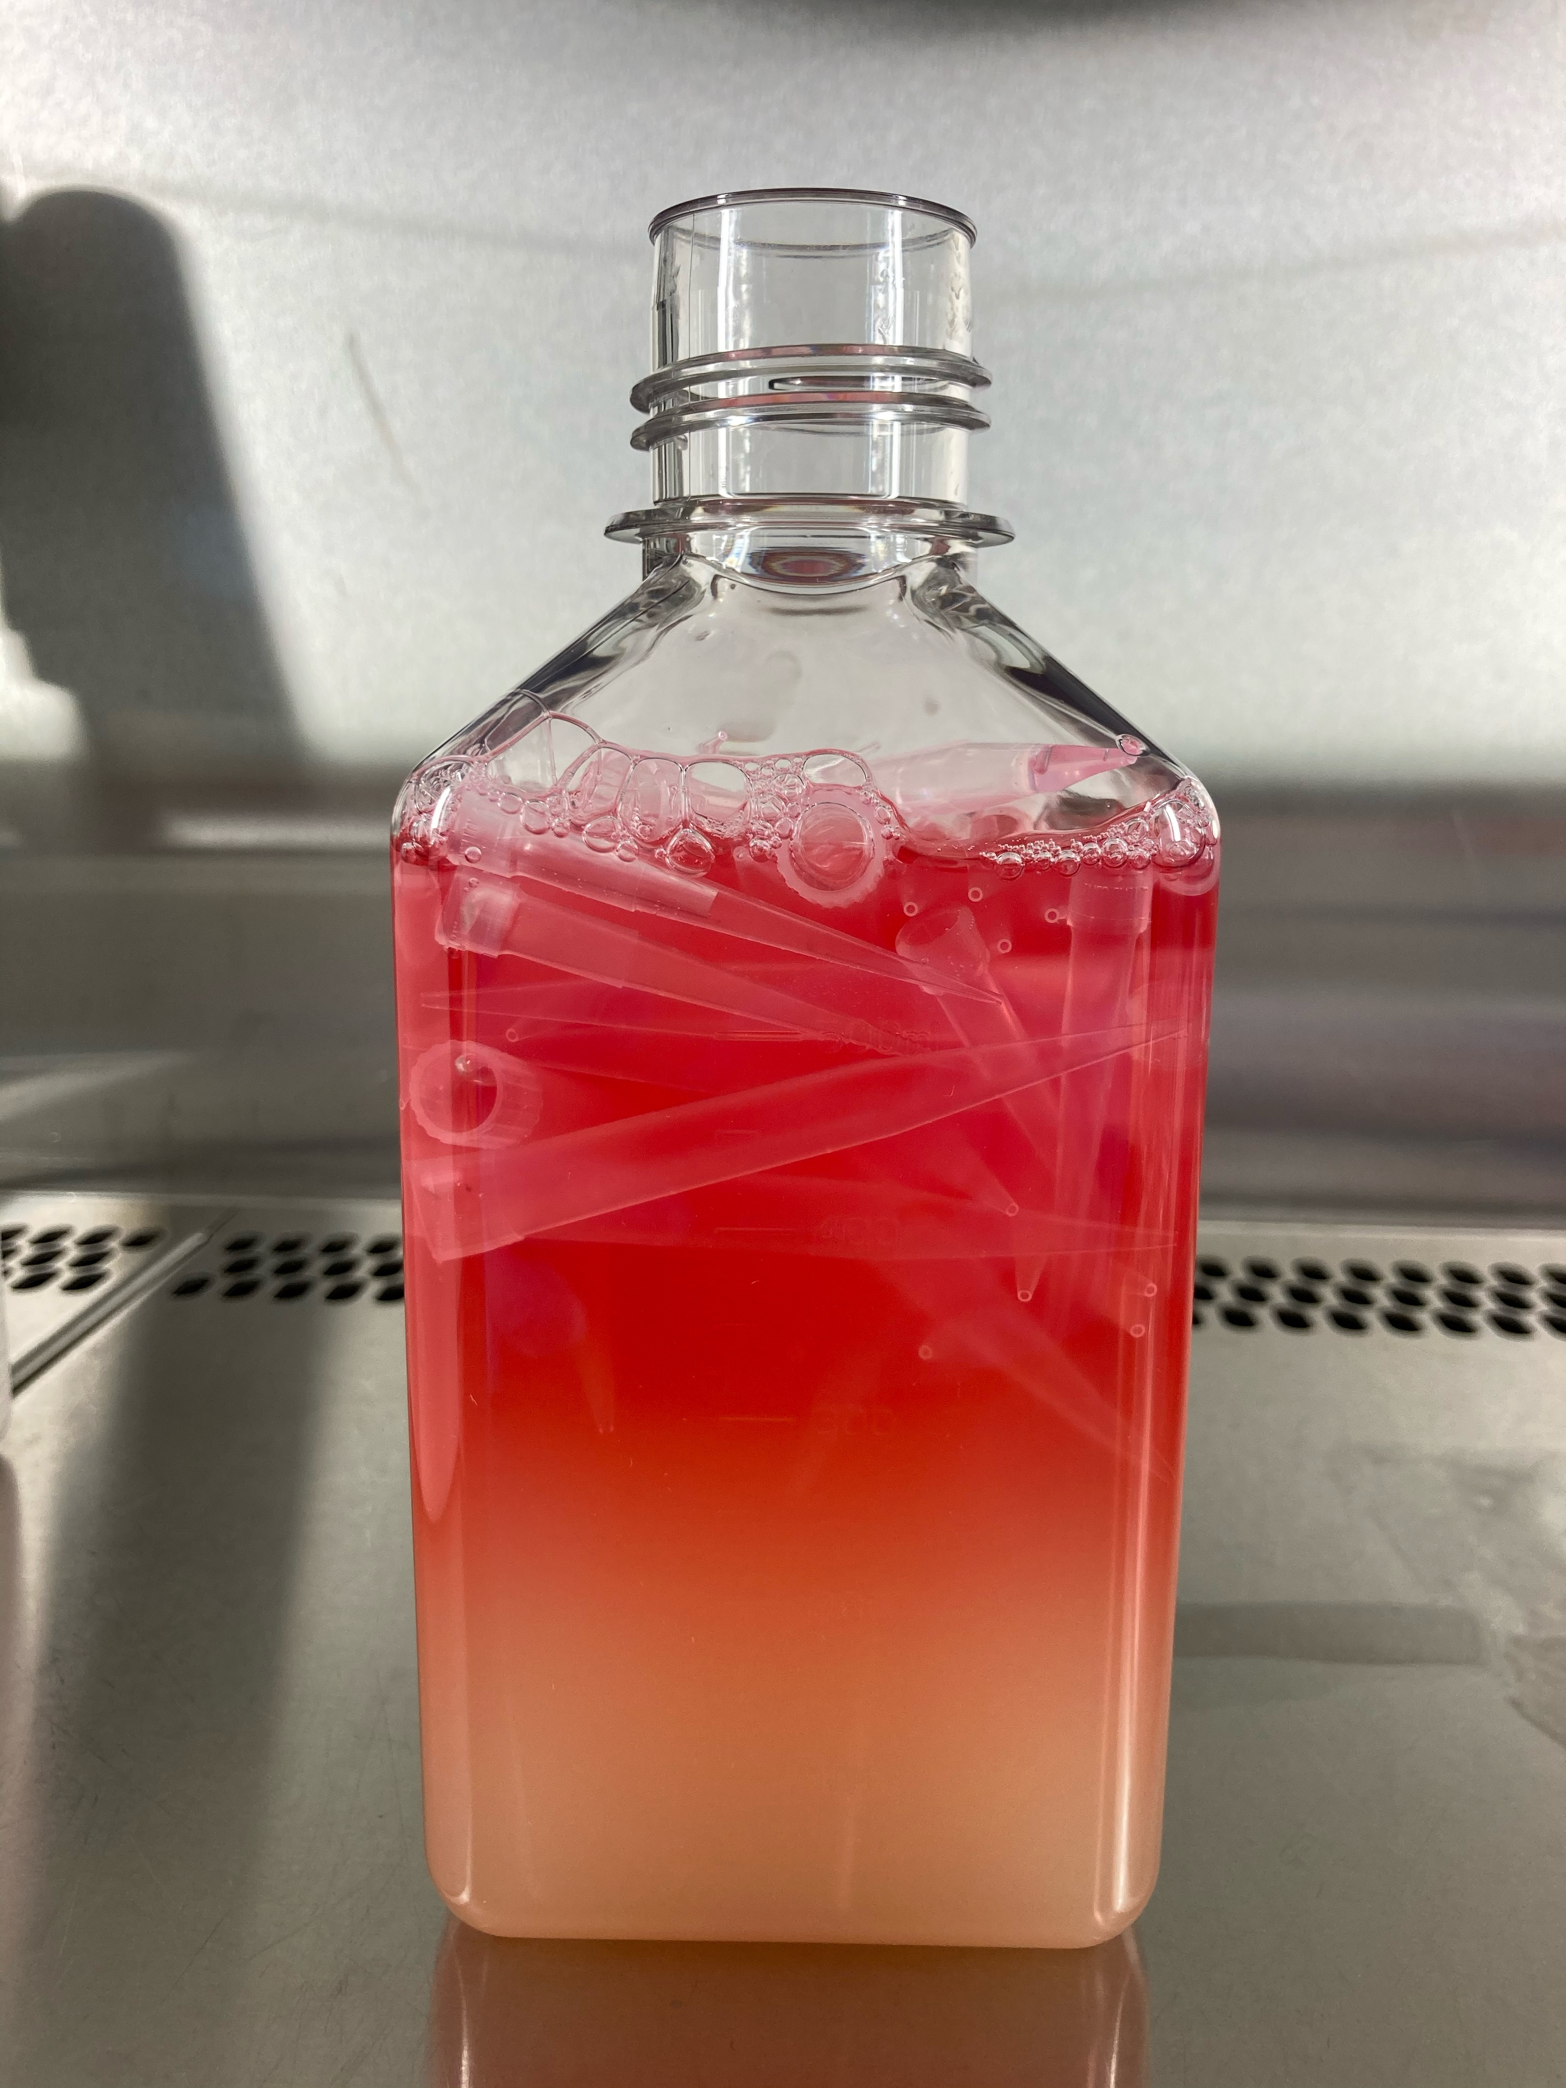
Picture 8
Fancy looking Waste bottle
Nomination: Anniken Olberg

Slide 13
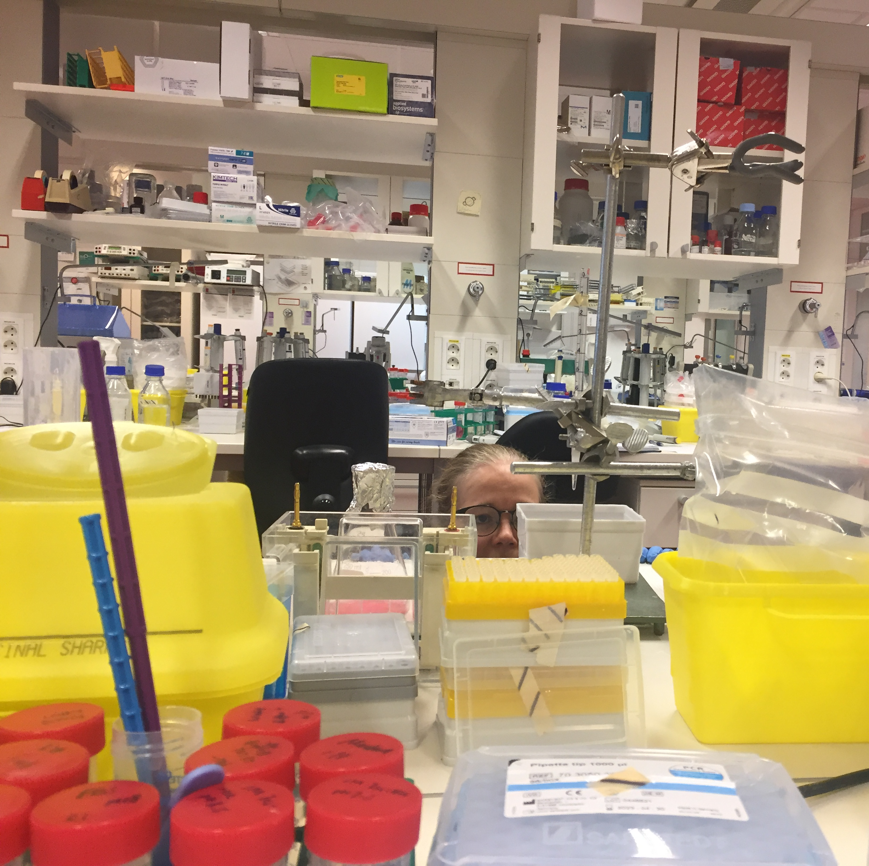
Picture 10
Nomination
Qindong Zhang

Slide 14
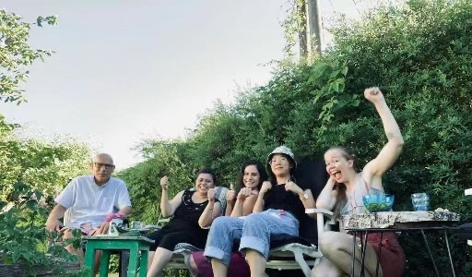
Picture 12
Nomination :
Qindong Zhang

Slide 15
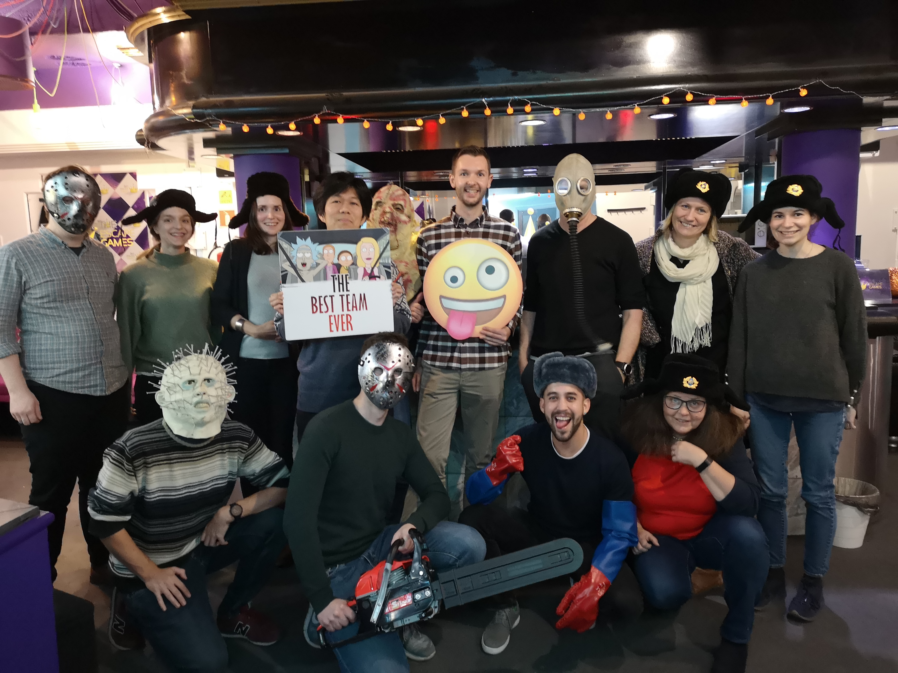
Picture 13
This picture from the Malmberg group's Escape room event.
Nomination: Lise kveberg

